Slide 1
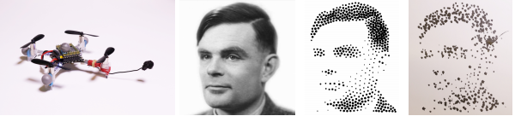
Stippling with aerial robots
B. Galea and E. Kia and N. Aird and P.G. Kry
School of Computer Science,
McGill University, Canada

Slide 2

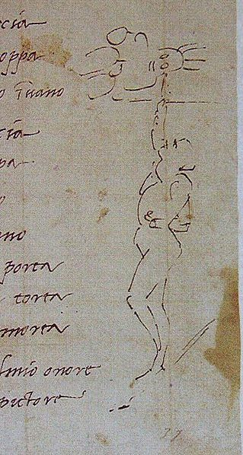
Introduction
Notes:
Sistine chapel – 11000 square feet of surface, 4 years to paint
Did not trust initial architects scaffolding – 60 feet high
Extremely uncomfortable

Slide 3
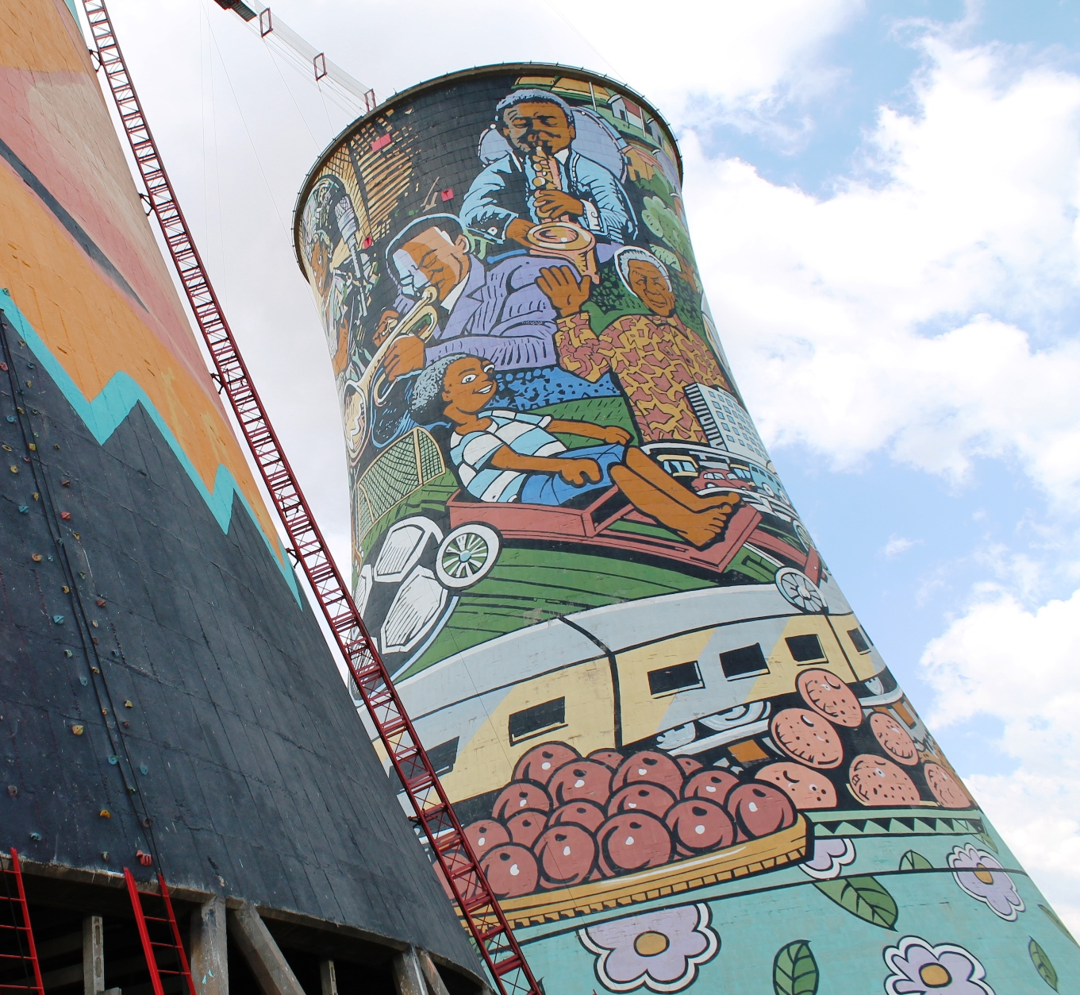
Introduction
Notes:
Caricature of Michelangelo with his head bent as far back as it would go
teaser?
Also more applicable example

Slide 4
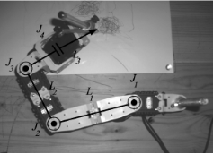
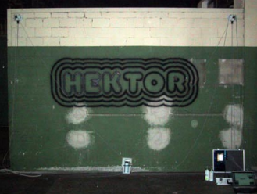
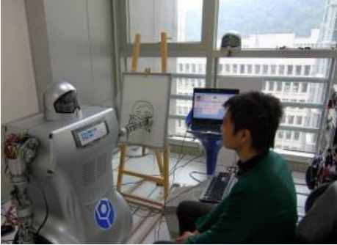
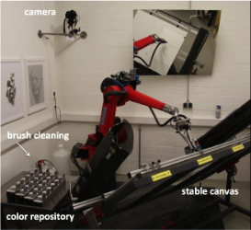
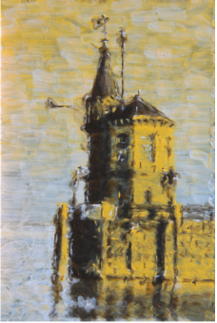
Drawing with robotics
TRESSET P (2013) Portrait drawing by Paul the robot.
LEHNI J (2002), Hektor: Diploma project at ECAL
LIN C.-Y (2009) Human portrait generation system for robot arm drawing.
LINDEMEIER T (2015), Hardware-based non-photorealistic rendering using a painting robot.
Notes:
Drawing robots
Paul the robot, tl12/13, lcm09, dlpt12 llpd15
Make into groups
Light painting quadrotors
Nobody doing flying robots yet… challenging! We only do stippling
Combine into one, show robots

Slide 5
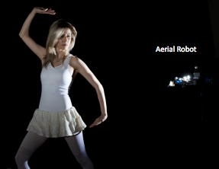
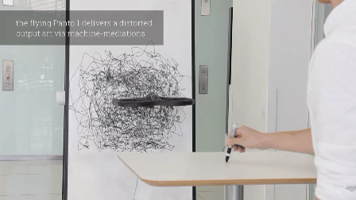
Flying robots in Art
SRIKANTH M (2014), Computational rim
illumination with aerial robots.
Sketchy MIT Media Lab

Slide 6
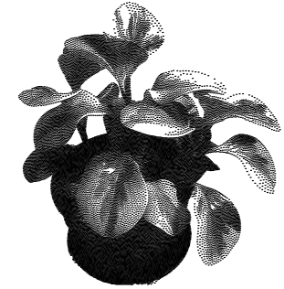
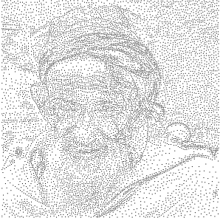
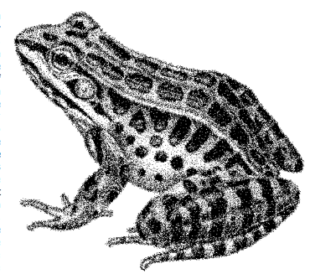
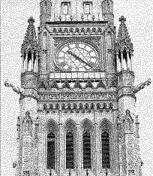
Stippling
MOULD D (2007), Stipple placement using distance in a weighted Graph
SECORD A (2002) Weighted Voronoi stippling
KIM S (2009), Stippling By Example
LI H., MOULD D diffusion (2011), Structure-preserving stippling by priority based error
Notes:
While our results would benefit from these recent advances, we use Secord’s method
because it is simple to implement, fast to compute for small stipple
counts, and easy to update during the drawing process to account
for errors in the placement of stipples

Slide 7
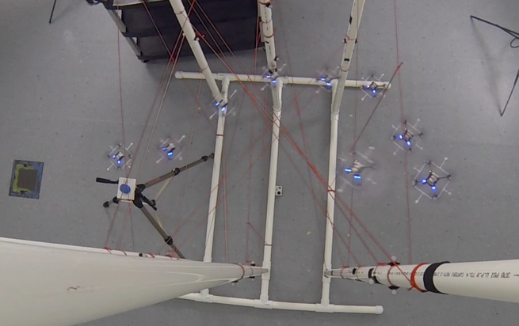
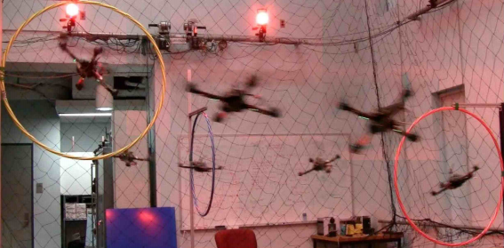
Aerial robot control
LANDRY B (2015), Planning and control for quadrotor flight through cluttered environments.
MELLINGER D (2012), Trajectory generation and control for precise aggressive maneuvers with quadrotors.
Notes:
Have errors, yes, because control Is hard…
Quadrotors underactuated… (other reasons why hard)... And who’s been solving these problems:
Landry Melinger (?) etc...

Slide 8
Our Approach
Filter Position
Compute desired force
Compute robot controls
Motion Capture
Position (100Hz)
Flight Control
Target pitch, roll,
yaw and thrust (100Hz)
Robot
Placement
Error
Stipple Target
Onboard PID
+
Speed Controller
(250Hz)
Stipple Server

Slide 9
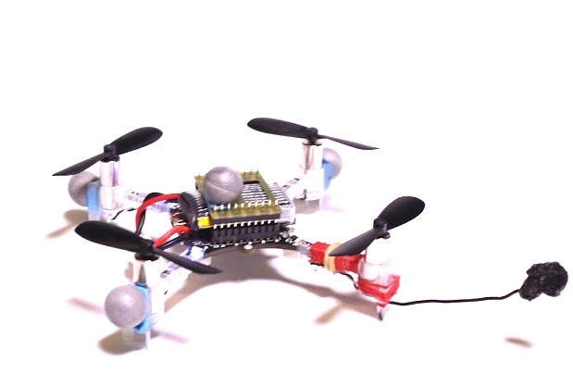
Quadrotor model
Point mass model
align its pitch and roll instantly
Offline system identification
Mass (30.0 grams)
No Inertia Tensor
Motor thrust calibration

Slide 10
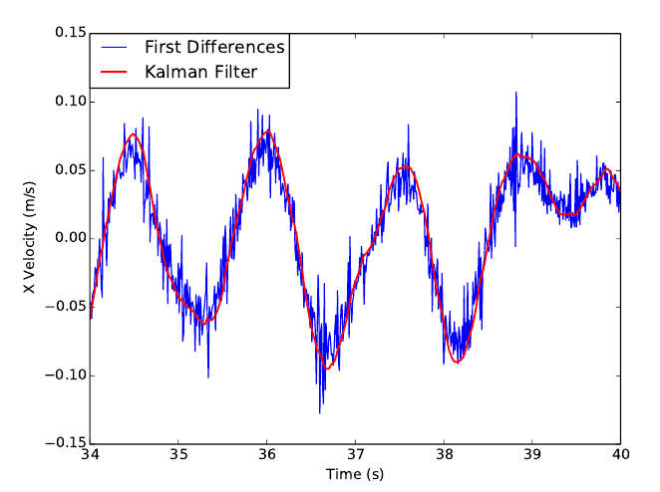
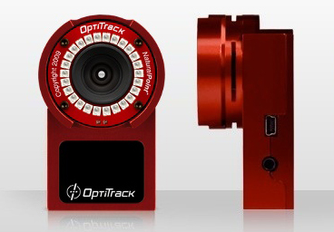
Kalman Filtering and State prediction
Smooth's position measurements from motion capture
Provides velocity
Predicts future state to counter system latency

Slide 11

Position Control
PID controller to reach and maintain a desired position
Computes desired net force acting on quadrotor
Send desired roll and pitch commands so the quadrotor is aligned with the force vector

Slide 12
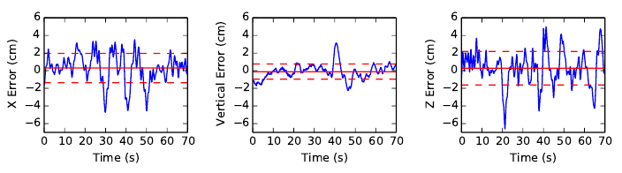
Hover Results
position error of quadrotor from target location over time
Solid and dotted red lines show the mean and standard deviation of the error respectively

Slide 13
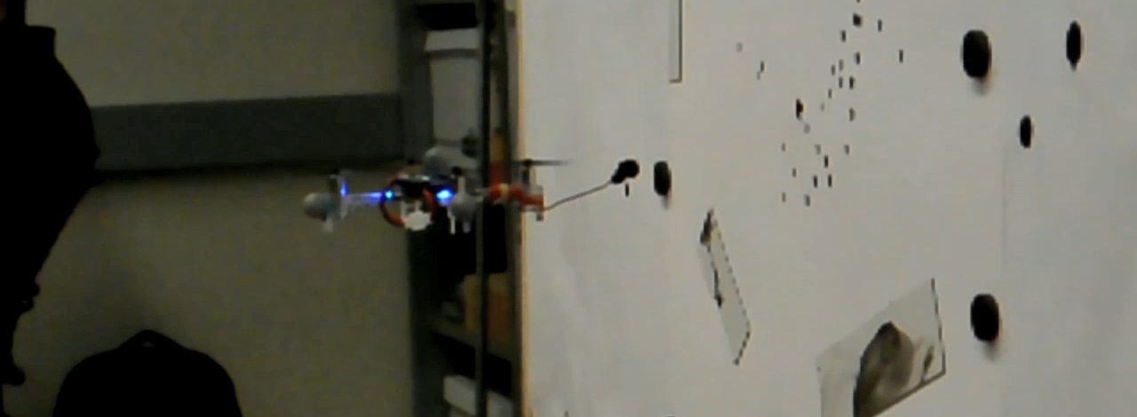
Stippling
Consists of 3 stages
Preparation
Stipple action
Recovery
1/16x Speed

Slide 14
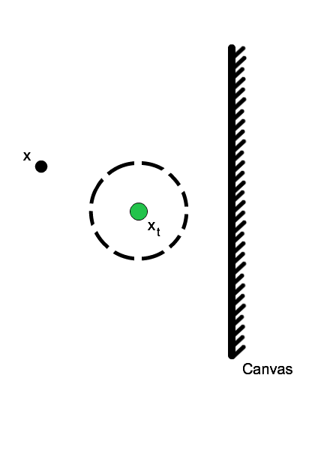
Stippling - Preparation
Uses hover controller to approach point normal to target canvas location
Only proceeds to stippling when hover error is below the desired accuracy threshold

Slide 15
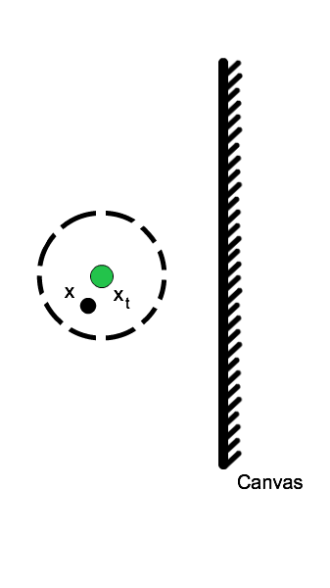
Stippling - Preparation
Uses hover controller to approach point normal to target canvas location
Only proceeds to stippling when hover error is below the desired accuracy threshold
Tradeoff between time and accuracy

Slide 16
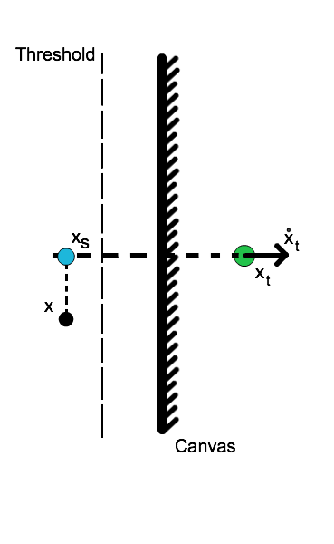
Stipple Action
Uses an additional PD controller in combination with normal position control
Acts on errors projected into plane of canvas

Slide 17
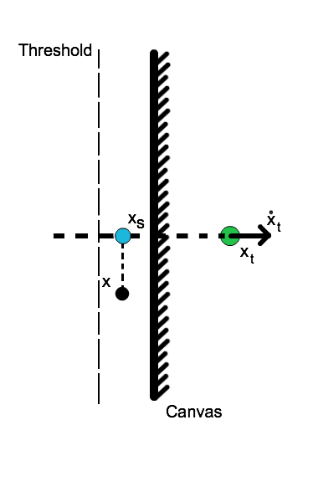
Stipple Action
Uses an additional PD controller in combination with normal position control
Acts on errors projected into plane of canvas
Detects stipple when distance to canvas below threshold

Slide 18
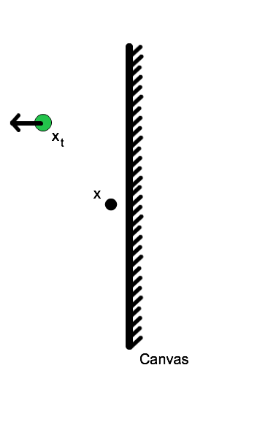
Stippling - Recovery
Target location near next stipple location
Lasts 50ms
Sets target velocity away from canvas

Slide 19
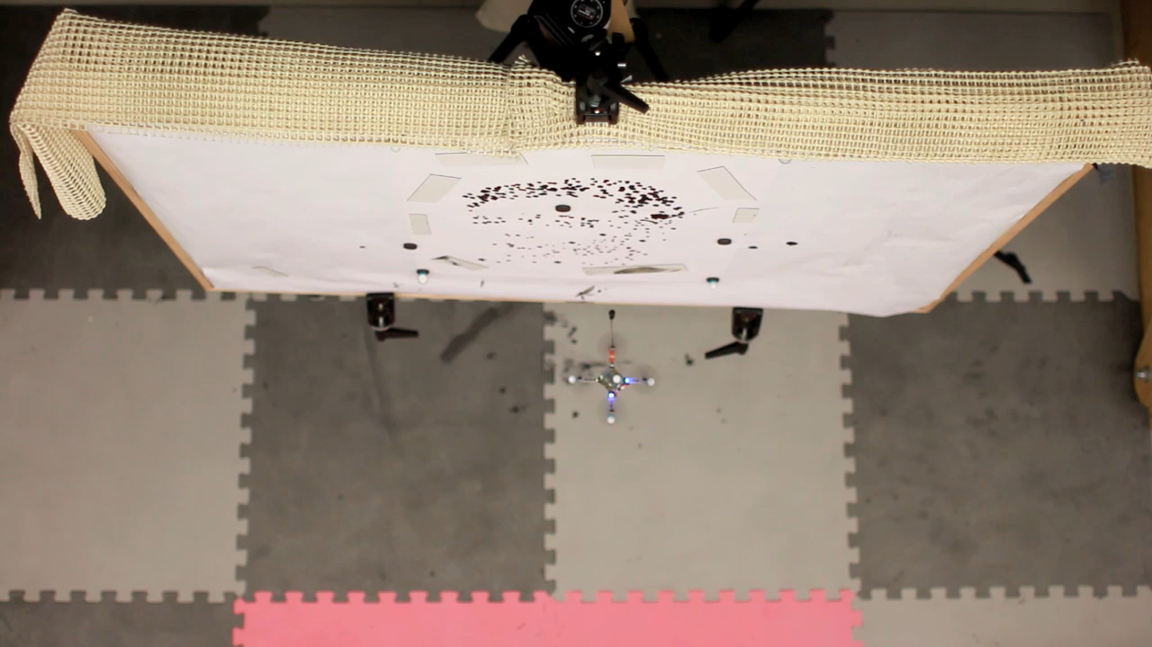
Stipple video Turing

Slide 20
Radio Communication Improvements
Existing communication not appropriate for real-time communication
Using queue with first-in first-out policy
Required ACKS with high retry count
Disconnect from quadrotor after retry count limit exceeded
Improved protocol
Send most recent command, drop older commands
Lower retry count
ACKs required only occasionally before disconnecting

Slide 21

Software based speed controller
Angular rotor speed generated by the motors is highly dependent on battery voltage
Battery voltage decreases over time and fluctuates based on amount of current being drawn by the motors
Proposed by Landry, runs onboard quadrotor and uses feedback on battery voltage

Slide 22
Stipple Generation and planning
High level planning for where to place stipples and in what order
Dynamically adjusts future stipple placements based on reported errors of previous stipples

Slide 23
Stipple Generation
stipple generation from a source image relies on weighted centroidal Voronoi diagrams (CVD)
CVD Algorithm
Start with initial random set of points
Until stable configuration is reached:
compute Voronoi diagram
compute region centroids
shift points to centroids

Slide 24

Stipple Generate

Slide 25
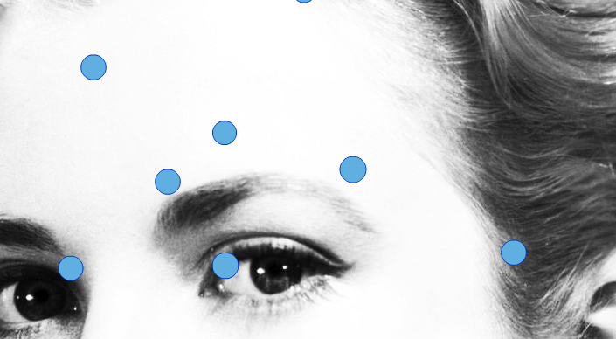
Stipple Generation

Slide 26
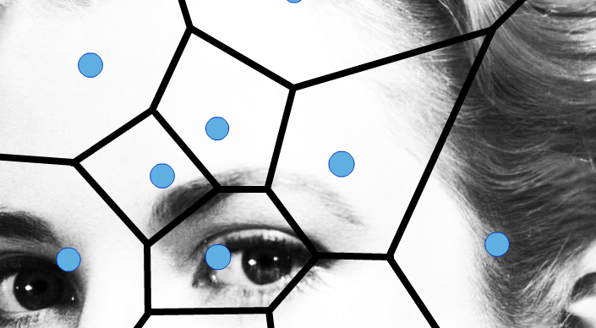
Stipple Generation

Slide 27
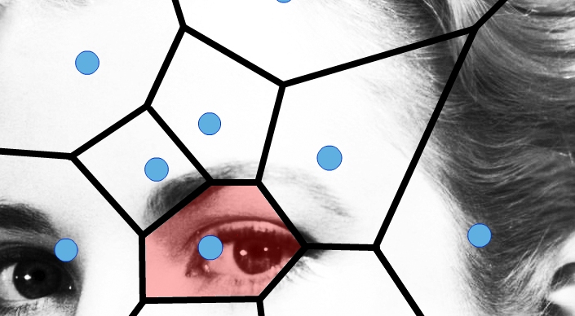
Stipple Generation

Slide 28

Stipple Generation

Slide 29
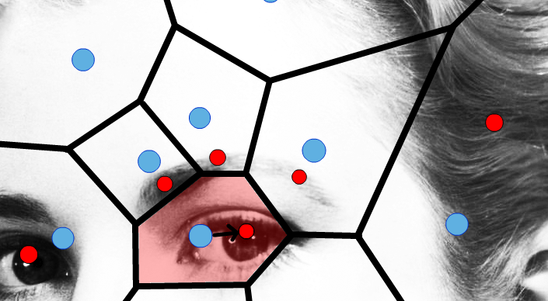
Stipple Generation

Slide 30
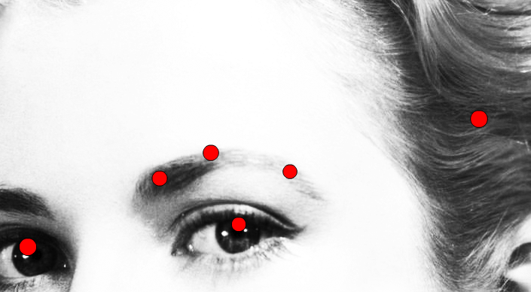
Stipple Generation

Slide 31

Stipple Generation

Slide 32
Dynamic Update
Attempts to mitigate errors in stipple placement by adjusting location of future stipples
Re-runs CVD algorithm with location of previous stipples fixed to update future locations

Slide 33
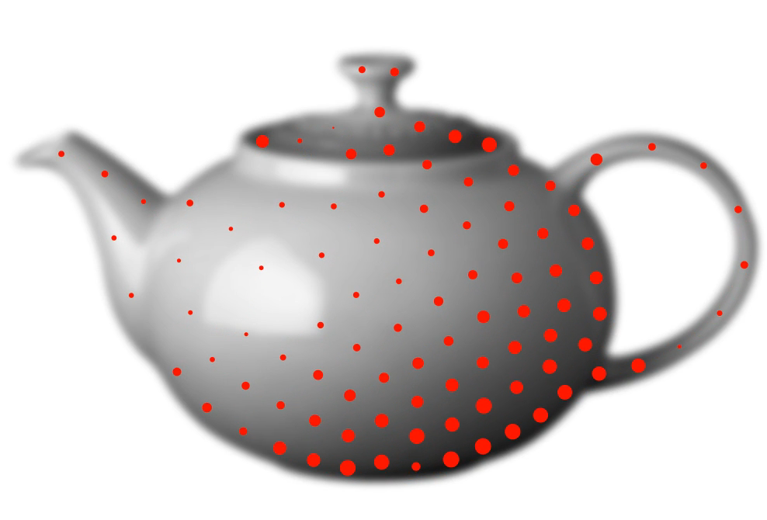
Dynamic Update
Notes:
Dynamic update works best when regions grow progressively, also faster convergence

Slide 34
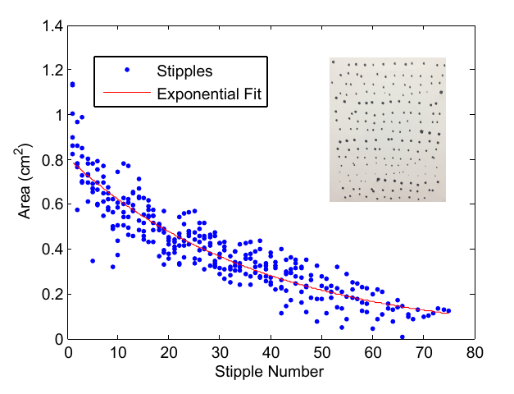
Ink Model
Simplified model relies only on number of stipples drawn
Used when planning the order that stipples should be drawn in
Notes:
Many parameters effect the appearance of a stipple such as sponge size and shape, velocity at impact, etc.

Slide 35
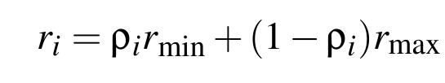
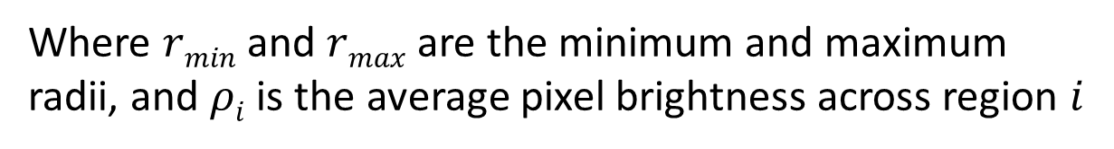
Stipple Size
Linearly maps the average brightness for each region to a stipple size
Minimum and maximum radii are computed using the ink model
Where $rmin$ and $rmax$ are the minimum and maximum radii, and $ρi$ is the average pixel brightness across region $i$

Slide 36
Path Planning
Three main factors influence the order in which we want to draw stipples
Minimize total distance travelled
Match stipple size to ink model as best as possible
Completed regions should be grown progressively to benefit from dynamic update
Notes:
Teapot video for demonstration

Slide 37
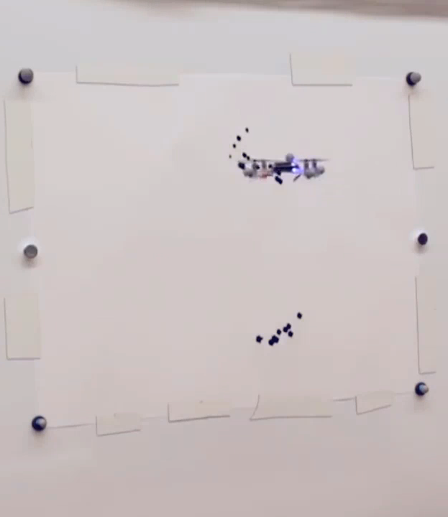
Path Planning
Uses a greedy strategy for stippling ordering

Slide 38
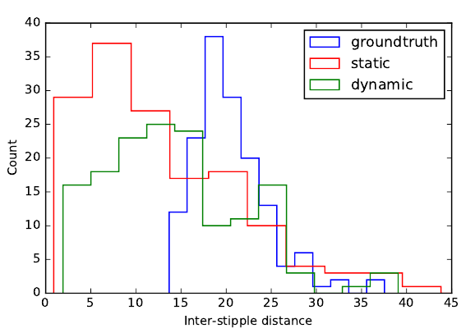
Dynamic Update – Synthetic Results
Histogram of the inter-stipple distance for the original output without errors (blue), the static stippling with error (red), and the dynamic error adjusted stippling (green), shown for stippling a teapot with 200 points and 1 % standard deviation Gaussian error.

Slide 39
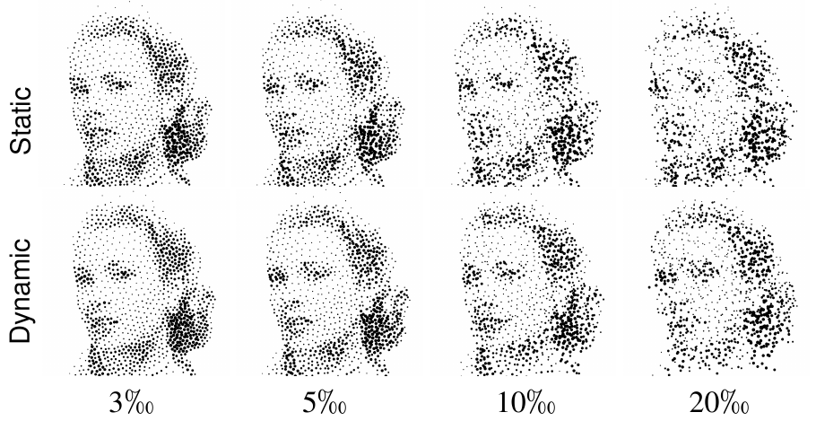
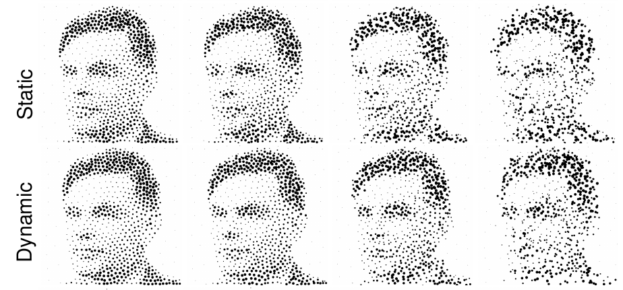
Dynamic Update – Synthetic Results
Comparison of synthetic results showing stipples drawn with and without dynamic stipple placement correction for different amounts of error. Error standard deviation of stipple locations in different columns is shown as a per-millimeter of the canvas size.

Slide 40
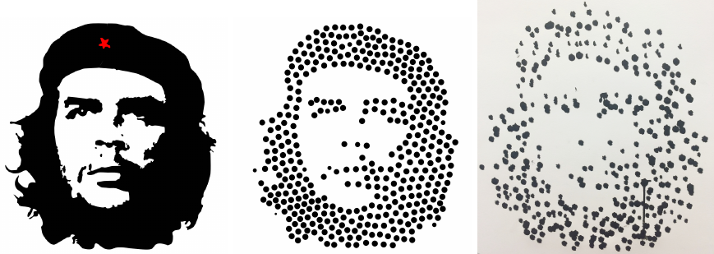
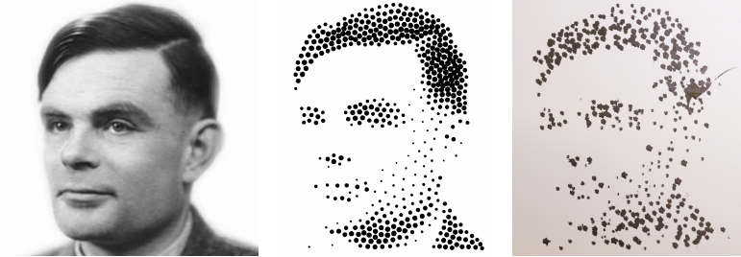
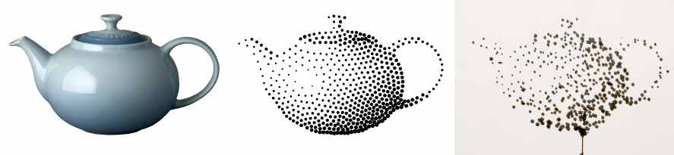
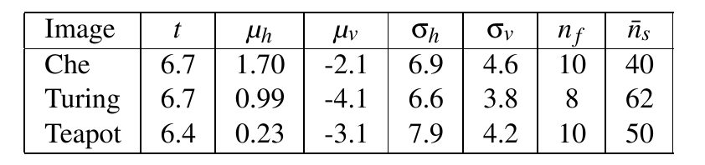
Physical Prints
Timing and error information for different prints
Notes:
Add videos refill, some timelapse, tethered video refilling

Slide 41
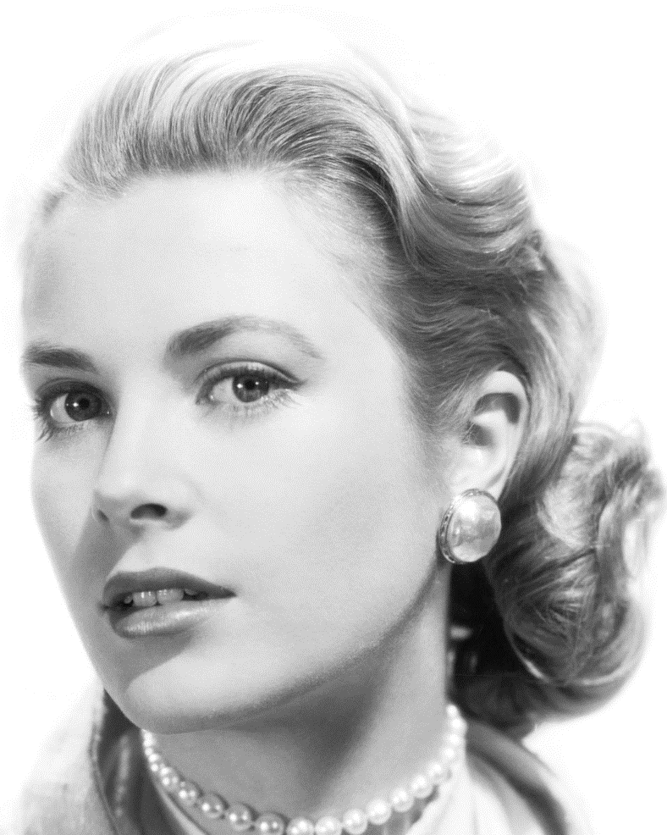
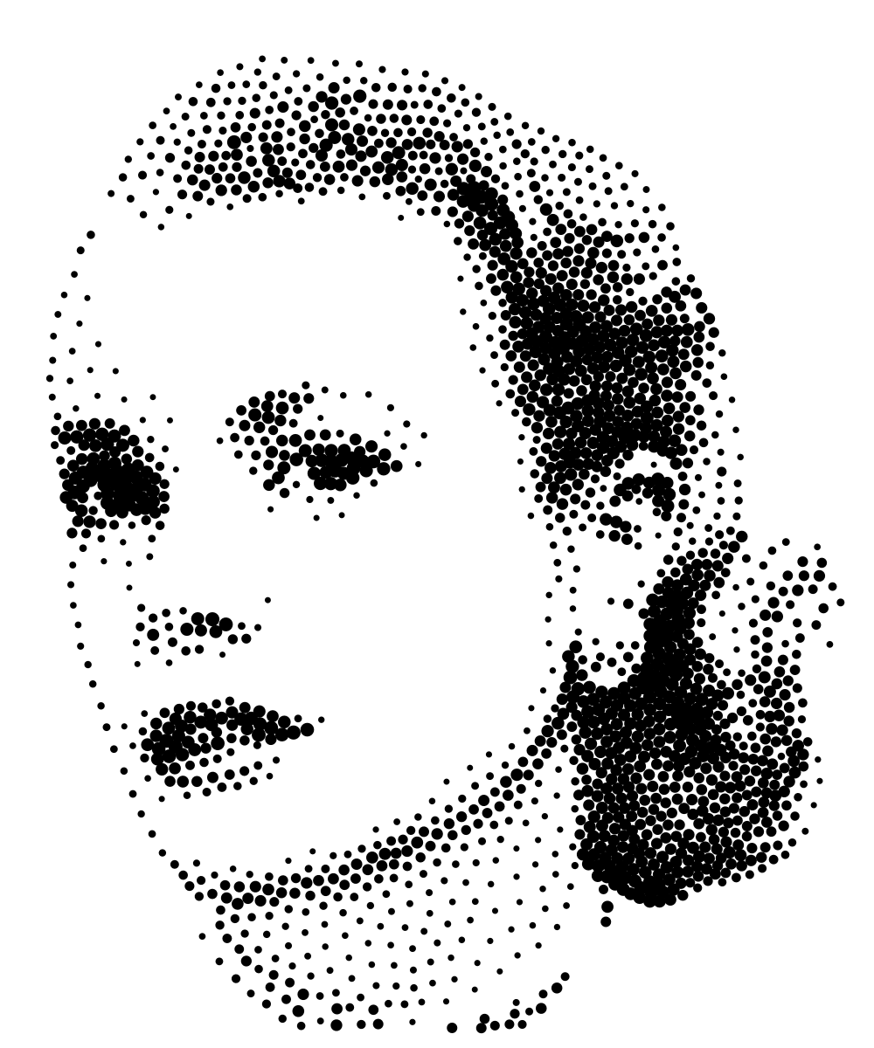
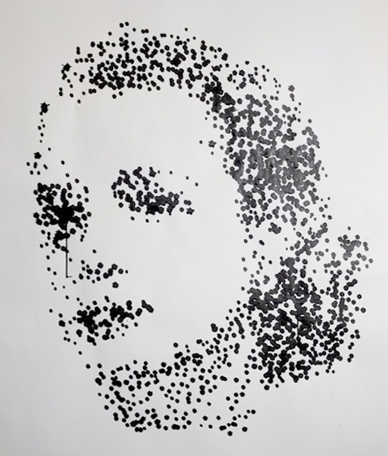
Physical Prints
Grace Kelly (2000 dots)

Slide 42
Conclusion
Low level details involved with aerial flight control
Stipple generation and path planning
Dynamic error correction

Slide 43
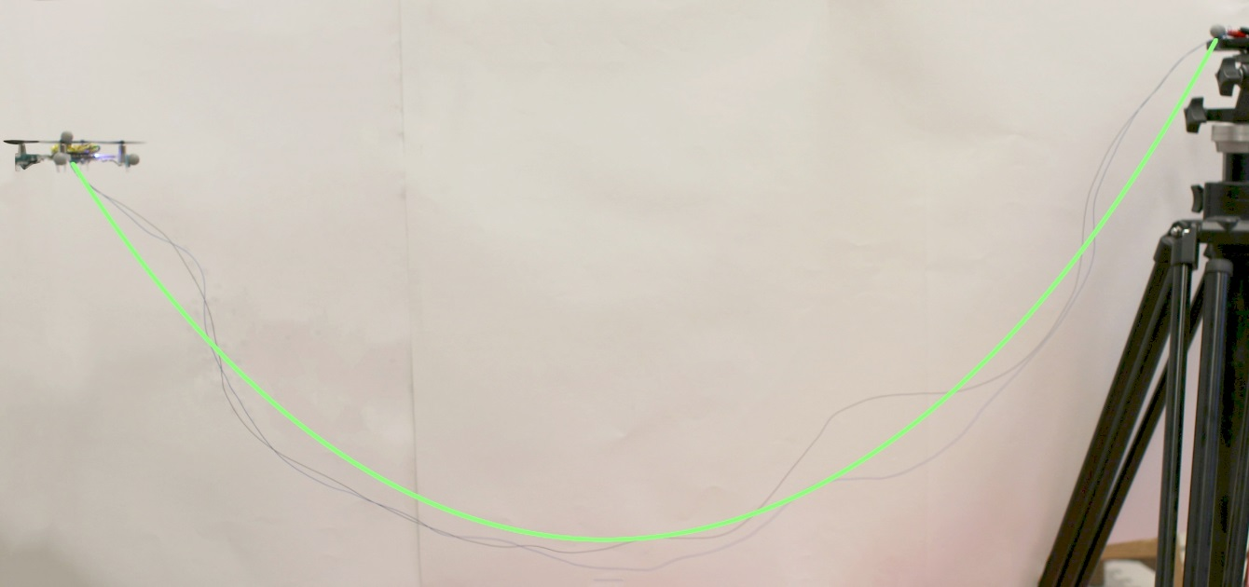
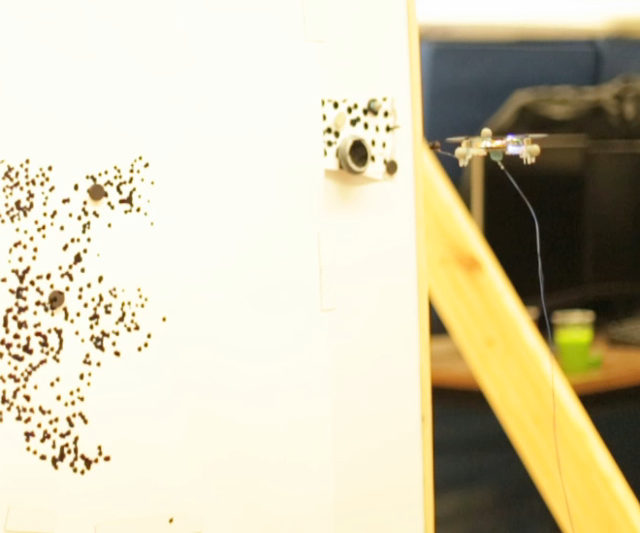
Future Work
Typical flight time on battery is less than 6 minutes
Wire tether for continuous flight
Model wire with catenary curve

Slide 44

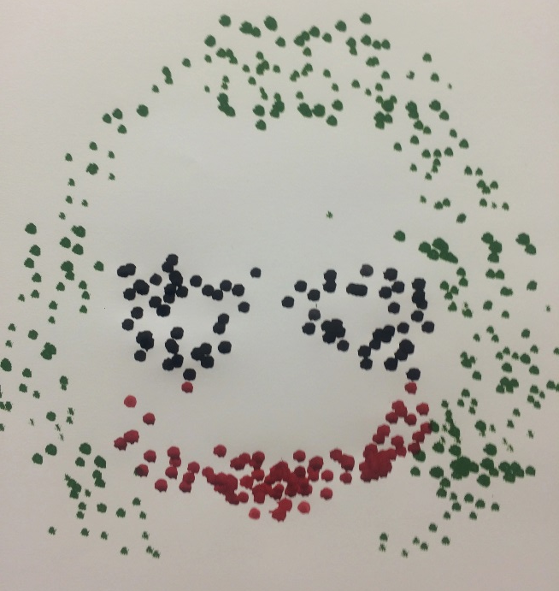

Future Work – Colored Prints
Joker (500 dots)

Slide 45


Future Work
Light painting
Multiple Quadrotor stippling

Slide 46

Thank you for listening

